Slide 1
Chapter – III
Authentication and Hash Function
Authentication requirements – Authentication functions – Message Authentication Codes – Hash Functions – Security of Hash Functions and MACs – MD5 message Digest algorithm – Secure Hash Algorithm – RIPEMD – HMAC Digital Signatures – Authentication Protocols – Digital Signature Standard- Case study on Swedbank

Slide 2
1.Authentication Requirements
Different attacks identified in communication across network includes:
Disclosure – release of message content.
Traffic Analysis - discovery of the pattern of traffic between parties.
Masquerade: Insertion of messages into the network from a fraudulent source.
Content Modification: Changes to the contents of a message.
Sequence Modification: Any modification to a sequence of messages between parties.
Timing Modification: Delay or replay of messages.
Source Repudiation: Denial of transmission of message by source.
Destination Repudiation: Denial of receipt of message by destination.

Slide 3
2.Authentication Functions
Message authentication or digital signature mechanism has two levels of functionality.
Lower level - a function that produces an authenticator to authenticate a message.
Higher level - enables a receiver to verify the authenticity of a message.
Types of functions that may be used to produce an authenticator.
Message Encryption - ciphertext of the entire message serves as its authenticator.
Message Authentication Code - A function of the message and a secret key that produces a fixed-length value.
Hash Function - A function that maps a message of any length into a fixed-length hash value.

Slide 4
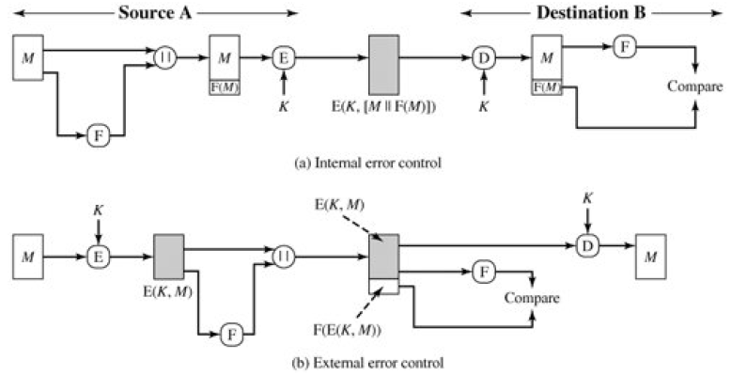
Internal & External Error Control

Slide 5
Internal & External Error Control
With internal error control, authentication is provided.
An opponent would have difficulty generating ciphertext that, when decrypted, would also need to have valid error control bits.
If the FCS is the outer code, an opponent can construct messages with valid error control codes.
Although the opponent cannot know what the decrypted plaintext will be, he or she can still hope to create confusion and disrupt operations.

Slide 6
2.a.Message Encryption
Message encryption by itself can provide a measure of authentication.
The analysis differs for symmetric and public-key encryption schemes.
I. Symmetric Encryption
A message M transmitted from source A to destination B is encrypted using a secret key K shared by A and B.
If no other party knows the key, then confidentiality is provided.
Symmetric encryption provides authentication as well as confidentiality.

Slide 7
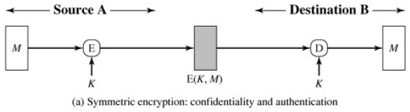
2.a.Message Encryption
B is assured that the message was generated by A.
Since A, is the only other party that possesses K.
if M is recovered, B knows that none of the bits of M have been altered, because an opponent that does not know K would not know how to alter bits in the ciphertext.

Slide 8
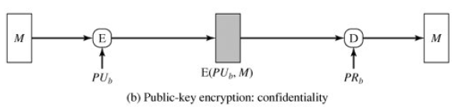
2.a.Message Encryption
II. Public Key Encryption
The straightforward use of public-key encryption provides confidentiality but not authentication.
Source (A) uses the public key PU_{b} of the destination (B) to encrypt message M.
Only B has the corresponding private key PR_{b}, only B can decrypt the message.
Provides no authentication because any opponent could also use B's public key to encrypt a message, claiming to be A.
Symmetric encryption provides authentication as well as confidentiality.

Slide 9
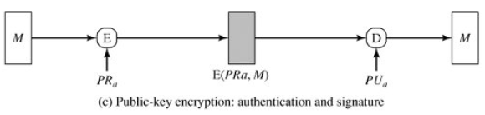
2.a.Message Encryption
To provide authentication, A uses its private key to encrypt the message, and B uses A's public key to decrypt.
Provides authentication using the same type of reasoning as in the symmetric encryption case
The message must have come from A because A is the only party that possesses PR_{a} .
Signature - The only party with the information necessary to construct ciphertext that can be decrypted with PU_{a}.

Slide 10
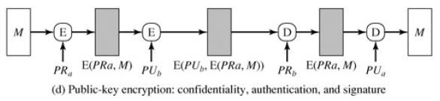
2.a.Message Encryption
A can encrypt M first using its private key, which provides the digital signature, and then using B's public key, which provides confidentiality.
B knows A’s public key so this authenticates that the message is from source A.

Slide 11
2.b.Message Authentication Code
Involves the use of a secret key to generate a small fixed-size block of data.
The generated cryptographic checksum or MAC is appended to the message.
This technique assumes that two communicating parties, say A and B, share a common secret key K.
When A has a message to send to B, it calculates the MAC as a function of the message and the key: MAC = C(K,M), where
M = input message.
C = MAC function.
K = shared secret key.
MAC = message authentication code.

Slide 12
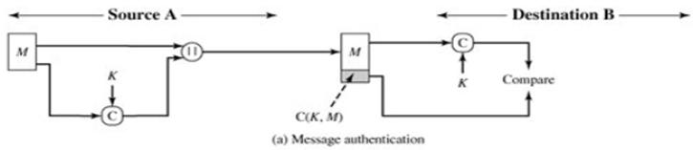
2.b.Message Authentication Code
The message plus MAC are transmitted to the intended recipient.
The recipient performs the same calculation on the received message, using the same secret key, to generate a new MAC.
The received MAC is compared to the calculated MAC.
The receiver is assured that the message has not been altered.
If an attacker alters the message but does not alter the MAC, then the receiver's calculation of the MAC will differ from the received MAC.
Because the attacker is assumed not to know the secret key, the attacker cannot alter the MAC to correspond to the alterations in the message.

Slide 13
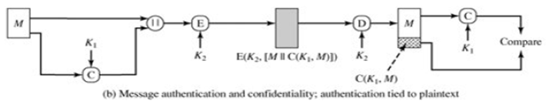
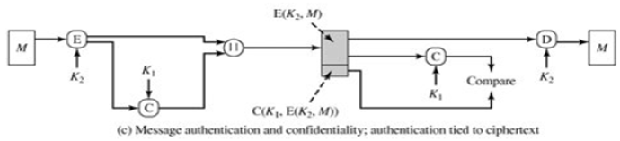
2.b.Message Authentication Code
The receiver is assured that the message is from the alleged sender.
Because no one else knows the secret key, no one else could prepare a message with a proper MAC.
The message includes a sequence number.
Therefore receiver can be assured of the proper sequence because an attacker cannot successfully alter the sequence number.

Slide 14
MAC Properties
a MAC is a cryptographic checksum.
MAC = C_{K}(M).
- condenses a variable-length message M.
- using a secret key K.
- to a fixed-sized authenticator.
Is a many-to-one function.
- potentially many messages have same MAC.
- but finding these needs to be very difficult.

Slide 15
Requirements for MAC
Taking into account the types of attacks
Need the MAC to satisfy the following:
1. Knowing a message and MAC, is infeasible to find another message with same MAC.
2. MACs should be uniformly distributed.
3. MAC should depend equally on all bits of the message.

Slide 16
2.c.Hash Function
A variation on the message authentication code is the one-way hash function.
A hash function accepts a variable-size message M as input and produces a fixed size output, referred to as a hash code H(M).
Unlike a MAC, a hash code does not use a key but is a function only of the input message.
The hash code is also referred to as a message digest or hash value.
The hash code is a function of all the bits of the message and provides an error-detection capability:
A change to any bit or bits in the message results in a change to the hash code.

Slide 17
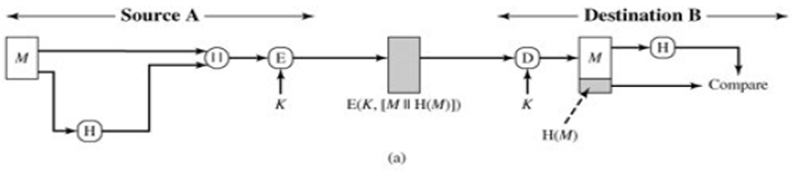
2.c.Hash Function
a) The message plus concatenated hash code is encrypted using symmetric encryption.
The hash code provides the structure or redundancy required to achieve authentication.
Since encryption is applied to the entire message plus hash code, confidentiality is also provided.

Slide 18
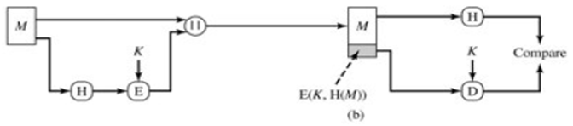
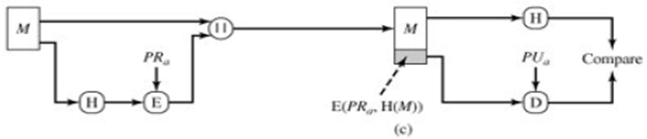
2.c.Hash Function
b) Only the hash code is encrypted, using symmetric encryption.
This reduces the processing burden for those applications that do not require confidentiality.
c) Only the hash code is encrypted, using public-key encryption and using the sender's private key.
As with (b), this provides authentication and also digital signature.

Slide 19
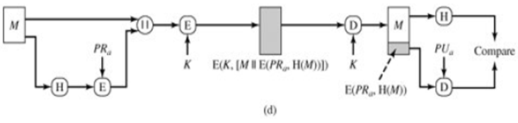
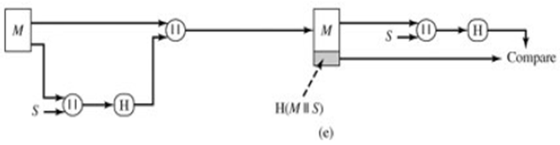
2.c.Hash Function
d) If confidentiality as well as a digital signature is desired, then the message plus the private-key encrypted hash code can be encrypted using a symmetric secret key.
e) It is possible to use a hash function but no encryption for message authentication.

Slide 20
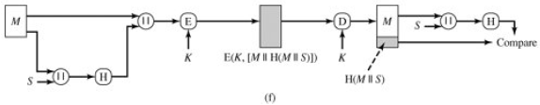
2.c.Hash Function
f) Confidentiality can be added to the approach of (e) by encrypting the entire message plus the hash code.

Slide 21
Requirements for Hash Functions
1.Can be applied to any sized message M.
2. Produces fixed-length output h.
3. Is easy to compute h=H(M) for any message M.
4. Given h is infeasible to find x such that H(x)=h.
- one-way property
5a. Given x, it is infeasible to find y such that H(y)=H(x)
- weak collision resistance
5b. Given x , it is infeasible to find any x, y such that H(y)=H(x)
- strong collision resistance

Slide 22
Birthday Attacks
Might think a 64-bit hash is secure, but by Birthday Paradox it is not.
Birthday attack works thus:
The source, A, is prepared to "sign" a message by appending the appropriate m-bit hash code and encrypting that hash code with A's private key.
Opponent generates 2^{m/2} variations of a valid message all with essentially the same meaning.
Opponent also generates 2^{m/2} variations of a desired fraudulent message.
Two sets of messages are compared to find pair with same hash (probability > 0.5 by birthday paradox)
Have user sign for the valid message, then substitute the forgery which will have a valid signature.

Slide 23
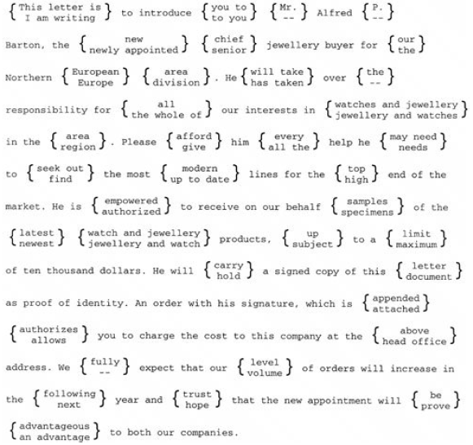
A letter in 2³⁷ Variations.

Slide 24
Meet-in-the-Middle Attack
1. Use the algorithm defined at the beginning of this subsection to calculate the unencrypted hash code G.
2. Construct any desired message in the form Q₁, Q₂,..., Q_{N-2}.
3. Compute for H_{i} = E(Q_{i}, H_{i-1}) for 1<= i <=(N-2).
4. Generate 2^{m/2} random blocks; for each block X, compute E(X, H_{N-2}).
Generate an additional 2^{m/2} random blocks; for each block Y, compute D(Y, G), where D is the decryption function corresponding to E.
5. Based on the birthday paradox, with high probability there will be an X and Y such that E(X, H_{N-2}) = D(Y, G).
6. Form the message Q1, Q2,..., Q_{N-2}, X, Y. This message has the hash code G and therefore can be used with the intercepted encrypted signature.

Slide 25
3.Secure Hash Algorithm
SHA originally designed by NIST & NSA in 1993.
Revised in 1995 as SHA-1.
US standard for use with DSA signature scheme
- standard is FIPS 180-1 1995, also Internet RFC3174
- nb. the algorithm is SHA, the standard is SHS
based on design of MD4 with key differences
produces 160-bit hash values
recent 2005 results on security of SHA-1 have raised concerns on its use in future applications.

Slide 26
Revised Secure Hash Standard
NIST issued revision FIPS 180-2 in 2002.
Adds 3 additional versions of SHA.
SHA-256, SHA-384, SHA-512.
Designed for compatibility with increased security provided by the AES cipher.
Structure & detail is similar to SHA-1.
Analysis should be similar.
Security levels are rather higher.

Slide 27
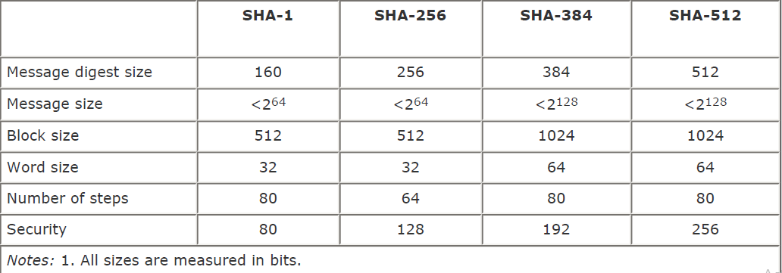
Comparison of SHA Parameters

Slide 28
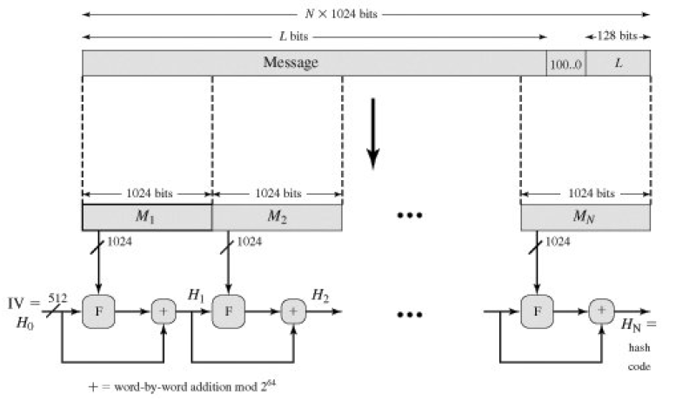
SHA-512 Overview

Slide 29
Steps involved in SHA-512
Step 1. Append padding bits - The message is padded so that its length is congruent to 896 modulo 1024.
- Padding is always added, even if the message is already of the desired length.
- Thus, the number of padding bits is in the range of 1 to 1024.
- The padding consists of a single 1-bit followed by the necessary number of 0-bits.
Step 2. Append length - A block of 128 bits is appended to the message.
- This block is treated as an unsigned 128-bit integer and contains the length of the original message.
- The outcome of the first two steps yields a message that is an integer multiple of 1024 bits in length.
- M₁, M₂,..., M_{N}, so that the total length of the expanded message is N x 1024 bits.

Slide 30
Steps involved in SHA-512
Step 3. Initialize Hash Buffer - A 512-bit buffer is used to hold intermediate and final results of the hash function.
- The buffer can be represented as eight 64-bit registers (a, b, c, d, e, f, g, h).
- These registers are initialized to the following 64-bit integers (hexadecimal values):
- Values are stored in big-endian format, which is the most significant byte of a word in the low-address (leftmost) byte position.
Hexadecimal Values in Hash Buffer
a = 6A09E667F3BCC908 | e = 510E527FADE682D1
b = BB67AE8584CAA73B | f = 9B05688C2B3E6C1F
c = 3C6EF372FE94F82B | g = 1F83D9ABFB41BD6B
d = A54FF53A5F1D36F1 | h = 5BE0CDI9137E2179

Slide 31
Steps involved in SHA-512 Compression Function
Step 4. Process Message in 1024 bit (128-word) blocks. Heart of the algorithm.
- Processing message in 1024-bit blocks.
- Consists of 80 rounds.
- Updating a 512-bit buffer.
- Uses a 64-bit value Wt derived from the current message block.
- A round constant based on cube root of first 80 prime numbers.
Step 5. Output - After all N 1024-bit blocks have been processed, the output from the Nth stage is the 512-bit message digest.

Slide 32
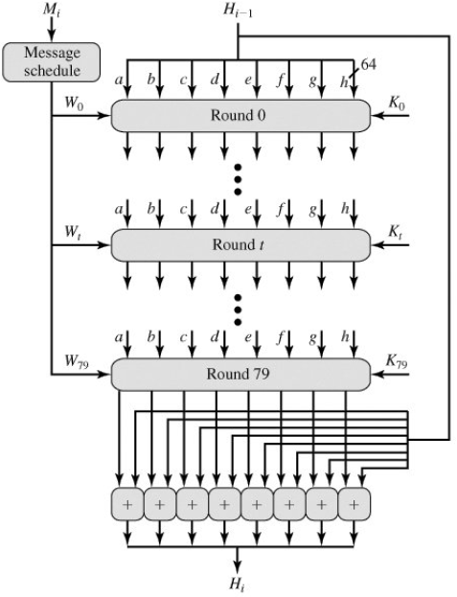
SHA-512 Processing of a Single 1024-bit block

Slide 33
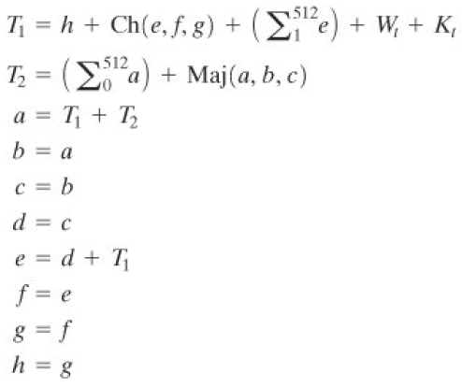


Round Function

Slide 34
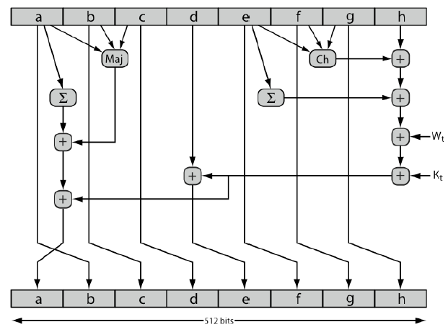
SHA-512 Round Function

Slide 35
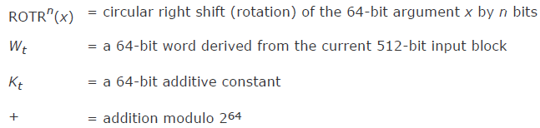

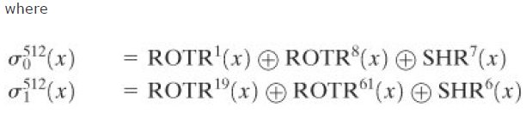

Round Function

Slide 36
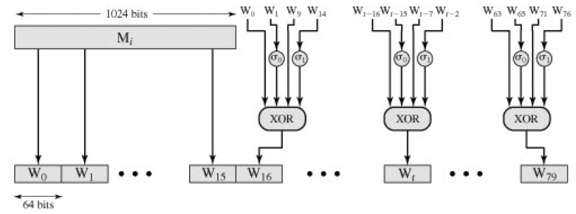
80 Word Input Sequence for SHA-512 Processing of Single Block

Slide 37
4.MD5 Algorithm
Developed by Ron Rivest at MIT.
When both brute-force and cryptanalytic concerns have arisen, MD5 was the most widely used secure hash algorithm.
The algorithm takes as input a message of arbitrary length and produces as output a 128-bit message digest.
The input is processed in 512-bit blocks.
Step 1: Appending padding bits.
The message is padded so that its length in bits is congruent to 448 modulo 512.
The length of the padded message is 64 bits less than an integer multiple of 512 bits.
Padding is always is added in the range of 1 to 512.
Single 1-bit followed by the necessary number of 0-bits.

Slide 38
Steps involved in MD5
Step 2: Append length - A 64-bit representation of the length in bits of the original message (before the padding) is appended to the result of step 1.
First two steps yields a message that is an integer multiple of 512 bits in length.
Expended message is represented as the sequence of 512-bit blocks Y₀,Y₁,....Y_{L-1}.
The total length of the expanded message is L × 512 bits.
Step 3: Initialize MD buffer - A 128-bit buffer is used to hold intermediate and final results of the hash function.
The buffer can be represented as four 32-bit registers (A, B, C, D).
A = 67452301 C = 98BADCFE
B = EFCDAB89 D = 10325476

Slide 39
Steps involved in MD5
These values are stored in little-endian format, which is the least significant byte of a word in the low-address byte position.
Word A: 01 23 45 67 Word C: FE DC BA 98
Word B: 89 AB CD EF Word D: 76 54 32 10
Step 4: Process message in 512-bit (16-word) blocks - a compression algorithm that consists of four “rounds” of processing.
Each round has a different primitive logical function, referred to as F, G, H, and I in the specification.
Each round takes as input the current 512-bit block being processed (Y_{q}) and the 28-bit buffer value ABCD and updates the contents of the buffer.
Each round also makes use of one-fourth of a 64-element table T[1…64] , constructed from the sine function.

Slide 40
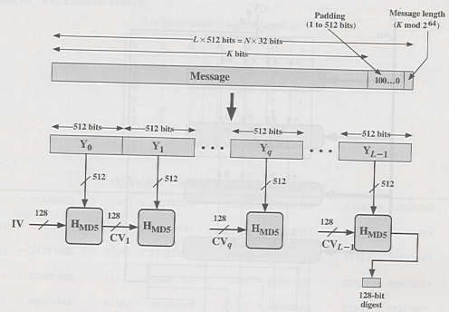
MD5 Overview
Step 5: Output - After all L 512-bit blocks have been processed, the output from the Lth stage is the 128-bit message digest.

Slide 41
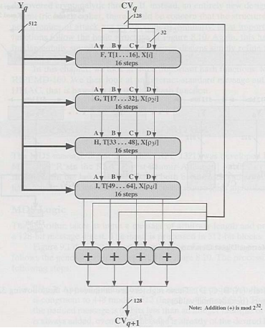
MD5 Processing of a 512-bit block

Slide 42
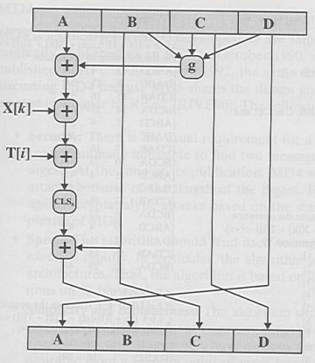
Elementary MD5 Operation

Slide 43
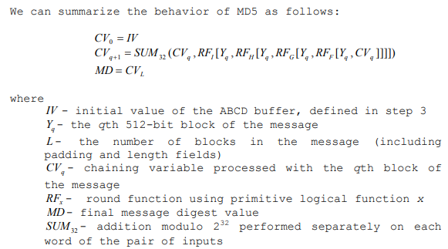
Terminologies used in MD5

Slide 44
5.HMAC
Motivations for HMAC
Cryptographic hash functions such as MD5 and SHA-1 generally execute faster in software than Symmetric block ciphers such as DES.
Library code for cryptographic hash functions is widely available.
A MAC and hash functions cannot be used directly because it does not rely on a secret key.
Number of proposals for the incorporation of a secret key into an existing hash algorithm.
HMAC has been issued as RFC 2104, has been chosen as the mandatory-to-implement MAC for IP security

Slide 45
HMAC Design Objectives
To use, without modifications, available hash functions.
Hash functions that perform well in software, and for which code is freely and widely available.
Allows easy replaceability of the embedded hash function in case faster or more secure hash functions are found or required.
Preserves the original performance of the hash function without incurring a significant degradation.
To use and handle keys in a simple way.
To understood cryptographic analysis of the strength of the authentication mechanism.

Slide 46
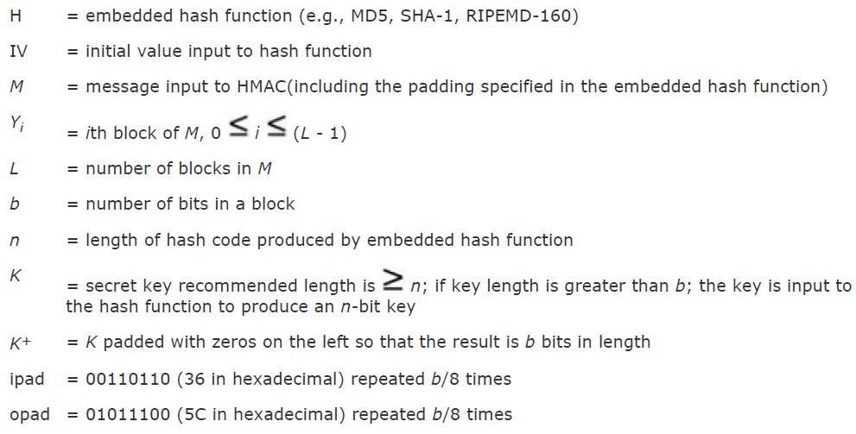
HMAC Algorithm

Slide 47
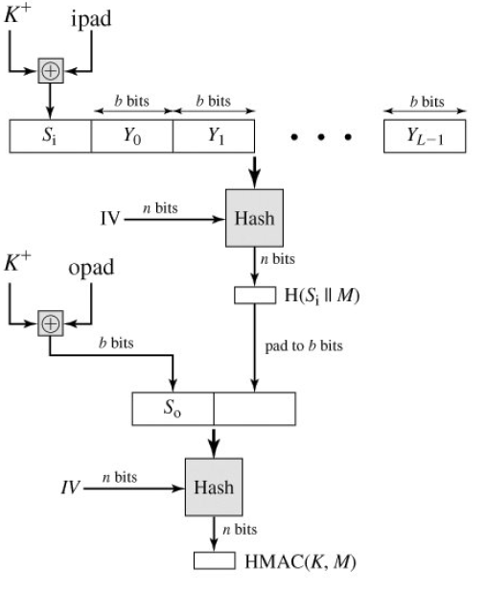
HMAC Structure

Slide 48
Steps in HMAC
Append zeros to the left end of K to create a b-bit string K⁺(e.g., if K is of length 160 bits and b = 512 then K will be appended with 44 zero bytes 0 x 00).
XOR (bitwise exclusive-OR) K⁺ with ipad to produce the b-bit block S_{i}.
Append M to S_{i}.
Apply H to the stream generated in step 3.
XOR K⁺ with opad to produce the b-bit block S_{o}
Append the hash result from step 4 to S_{o}
Apply H to the stream generated in step 6 and output the result.

Slide 49
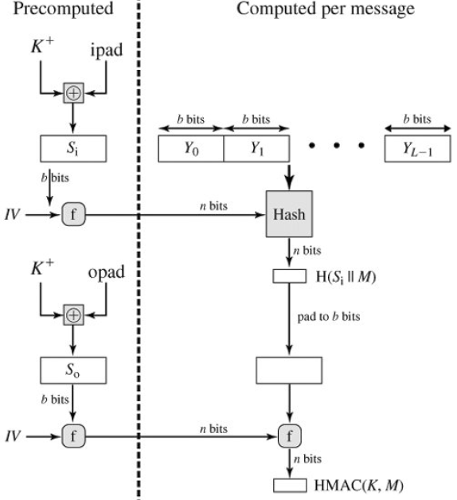
Efficient Implementation of HMAC

Slide 50
Security of HMAC
Proved security of HMAC relates to that of the underlying hash algorithm.
Attacking HMAC requires either:
Brute force attack on key used.
Birthday attack (but since keyed would need to observe a very large number of messages)
Choose hash function as a tradeoff between speed verses security constraints.

Slide 51
6.Digital Signatures
Have looked at message authentication
- but does not address issues of lack of trust
Digital signatures provide the ability to:
- verify author, date & time of signature
- authenticate message contents
- be verified by third parties to resolve disputes
Able to include authentication function with additional capabilities.

Slide 52
Digital Signature Properties
Must depend on the message signed.
Must use information unique to sender.
- to prevent both forgery and denial.
Must be relatively easy to produce.
Must be relatively easy to recognize & verify.
Be computationally infeasible to forge.
- with new message for existing digital signature.
- with fraudulent digital signature for given message.
Be practical to save digital signature in storage.

Slide 53
A.Direct Digital Signatures
Involve only sender & receiver.
Assumed receiver has sender’s public-key.
Digital signature made by sender signing entire message or hash with private-key.
Can encrypt using receivers public-key.
Important that sign first then encrypt message & signature.
Security depends on sender’s private-key.

Slide 54
B.Arbitrated Digital Signatures
Involves use of arbiter A.
- Validates any signed message.
- Dated and sent to recipient.
Requires suitable level of trust in arbiter.
Can be implemented with either private or public-key algorithms.
Arbiter may or may not see message.

Slide 55
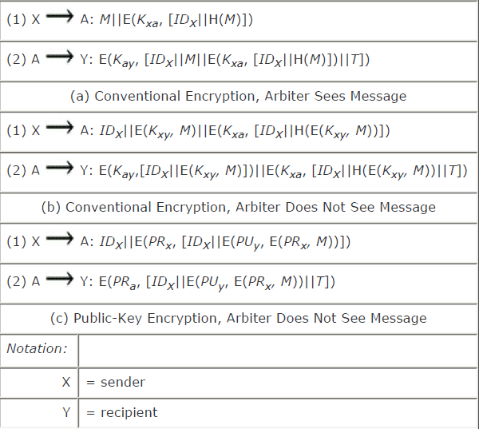
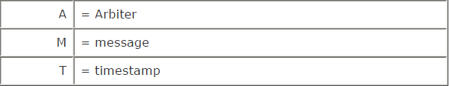
Arbitrated Digital Signature Techniques

Slide 56
7.Authentication Protocols
Used to convince parties of each others identity and to exchange session keys.
May be one-way or mutual.
Key issues are
- confidentiality – to protect session keys
- timeliness – to prevent replay attacks
Published protocols are often found to have flaws and need to be modified.

Slide 57
Replay Attacks
A valid signed message is copied and later resent.
- Simple replay.
- Repetition that can be logged.
- Repetition that cannot be detected.
- Backward replay without modification.
countermeasures include
- Use of sequence numbers (generally impractical).
- Timestamps (needs synchronized clocks).
- Challenge / response (using unique nonce).

Slide 58
Using Symmetric Key Encryption
As discussed previously can use a two level hierarchy of keys.
Provides confidentiality for communication in a distributed environment.
Usually with a trusted Key Distribution Center (KDC).
- each party shares own master key with KDC.
- KDC generates session keys used for connections between parties.
- master keys used to distribute these to them.

Slide 59
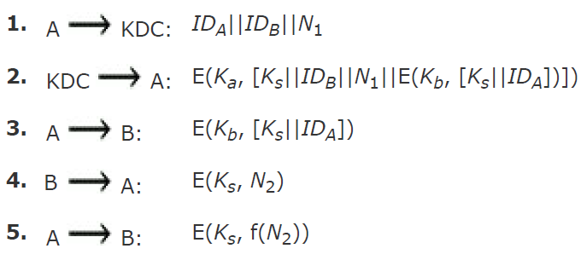
Needham-Schroeder Protocol
Original third-party key distribution protocol.
For session between A B mediated by KDC.
Protocol overview is:
Secret keys Ka and Kb are shared between A and the KDC and B and the KDC.

Slide 60
Needham-Schroeder Protocol
Used to securely distribute a new session key for communications between A & B.
But is vulnerable to a replay attack if an old session key has been compromised.
- then message 3 can be resent convincing B that is communicating with A.
Modifications to address this require:
- timestamps (Denning 81)
- using an extra nonce (Neuman 93)

Slide 61
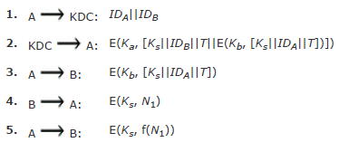
Denning’s AS Protocol
Denning 81 presented the following:
note: session key is chosen by A, hence AS need not be trusted to protect it.
timestamps prevent replay but require synchronized clocks.

Slide 62
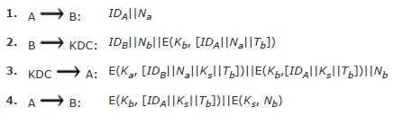
Newman 93a
To respond to the concerns about suppress-replay attacks and at the same time fix the problems in the Needham/Schroeder protocol.
Provides an effective, secure means for A and B to establish a session with a secure session key.
Leaves A in possession of a key that can be used for subsequent authentication to B.

Slide 63


Using Public Key Encryption
Have a range of approaches based on the use of public-key encryption.
Need to ensure have correct public keys for other parties.
Using a central Authentication Server (AS).
Various protocols exist using timestamps or nonces.

Slide 64

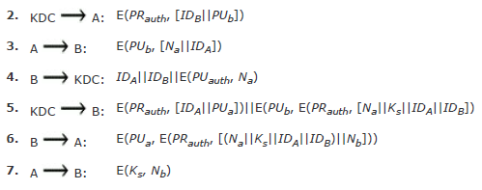
Woo & Lam’s Approach
The identifier of A, IDA, is added to the set of items encrypted with the KDC's private key in steps 5 and
6. This binds the session key Ks to the identities of the two parties that will be engaged in the session.

Slide 65
One-Way Authentication & Symmetric Encryption
Required when sender & receiver are not in communications at same time (eg. email)
Have header in clear so can be delivered by email system.
May want contents of body protected & sender authenticated.
Symmetric Encryption
Can refine use of KDC but can’t have final exchange of nonces, vis:
1. A->KDC: ID_{A} || ID_{B} || N₁
2. KDC -> A: E_{Ka} [Ks || ID_{B} || N₁ || E_{Kb} [Ks ||ID_{A}] ]
3. A -> B: E_{Kb} [Ks||ID_{A}] || E_{Ks} [M]
Does not protect against replays, could rely on timestamp in message, though email delays make this problematic.

Slide 66
Public Key Approaches
Have seen some public-key approaches
if confidentiality is major concern, can use:
A->B: E_{PUb} [Ks] || E_{Ks} [M]
has encrypted session key with B’s public key and message with common secret key.
if authentication needed use a digital signature with a digital certificate:
A->B: M || E_{PRa} [H(M)] || E_{PRas} [T||ID_{A}||PU_{a}]
with message, signature, certificate.

Slide 67
8.Digital Signature Standards
US Govt approved signature scheme
designed by NIST & NSA in early 90's
published as FIPS-186 in 1991
revised in 1993, 1996 & then 2000
uses the SHA hash algorithm
DSS is the standard, DSA is the algorithm
FIPS 186-2 (2000) includes alternative RSA & elliptic curve signature variants

Slide 68
Digital Signature Algorithm
Creates a 320 bit signature.
Able to provide 512-1024 bit security.
Smaller and faster than RSA.
Follows digital signature scheme only.
Security depends on difficulty of computing discrete logarithms.
A variant of ElGamal & Schnorr schemes.

Slide 69
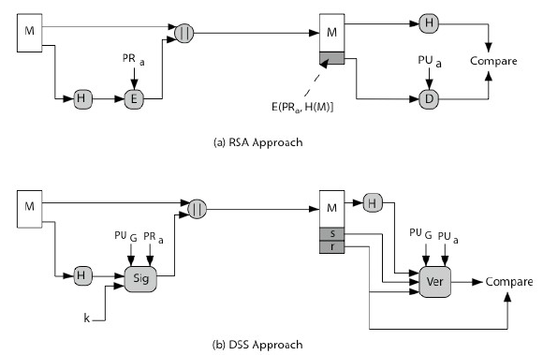
Digital Signature Algorithm

Slide 70
DSA Key Generation
Have shared global public key values (p, q, g):
Choose q, a 160 bit.
Choose a large prime p = 2^{L}, where L= 512 to 1024 bits and is a multiple of 64.
q is a prime factor of (p-1).
Choose g = h^{(p-1)/q}, where h<p-1, h^{(p-1)/q} (mod p) > 1.
users choose private & compute public key:
Choose x<q.
Compute y = g^{x} (mod p).

Slide 71

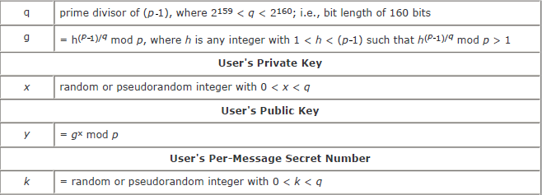
DSA Key Generation

Slide 72
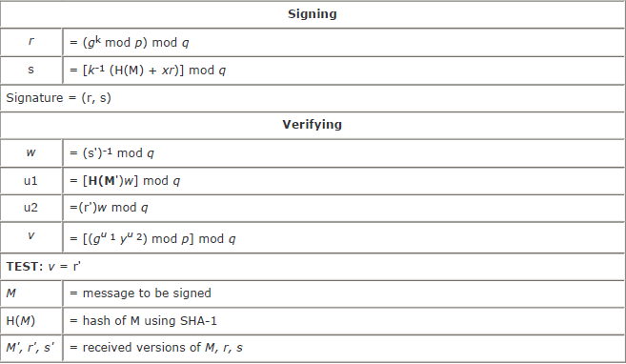
DSA Key Generation

Slide 73
DSA Signature Creation
to sign a message M the sender:
- generates a random signature key k, k<q.
- k must be random, be destroyed after use, and never be reused.
Computes signature pair:
- r = (g^{k}(mod p))(mod q).
- s = (k⁻¹.H(M)+ x.r)(mod q).
sends signature (r,s) with message M.

Slide 74
DSA Signature Verification
Having received M & signature (r,s)
To verify a signature, recipient computes:
w = s⁻¹(mod q)
u1= (H(M).w)(mod q)
u2= (r.w)(mod q)
v = (g^{u1}.y^{u2}(mod p)) (mod q)
if v==r then signature is verified.

